Slide 1

Akash Manjunatha School of Computing National College of Ireland Dublin, Ireland Student ID: x2114179
Machine Learning Techniques
in Automobile Domain

Slide 2

INTRODUCTION
Used cars
&
Car insurance
claim
Pricing is a major issue in the Used car price prediction it requires a platform for used car firms and people to identify the price that has been quoted for the proper price.
Automobile insurance claim: The company needs a strategic model that incorporates a variety of variables to forecast the likelihood of a fraud claim being filed in the following year.
Research question:
a) How to Predict used car prices using historical data of cars?
b) Do the additional features of cars help in predicting the car prices better?
c) Who are the target customers are likely going to false claim the vehicle insurance?

Slide 3
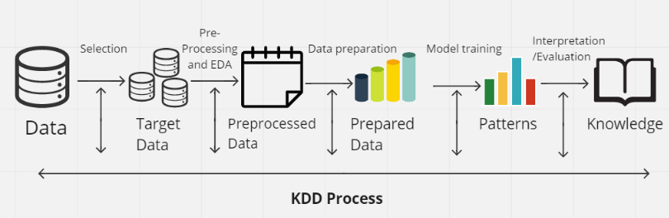
METHODOLOGY
Used cars
&
Car insurance
claim
Knowledge Discovery in Databases(KDD)
Data Selection,
Pre-processing and EDA,
Data preparation,
Model training and Evaluation performance,
Interpretation.

Slide 4
Machine Learning Algorithms
Used cars
&
Car insurance
claim
Random Forest.
k-nearest neighbors (KNN).
XG Boost.
Lasso regression
Support vector machines (SVMs)
Commonly used
for all the Datasets
Used for Regression Dataset-1 & 2
Used for Classification Dataset-3

Slide 5
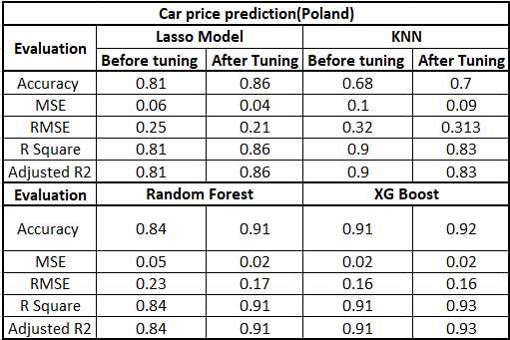
Result Summary Car price prediction Dataset-1
Used cars
&
Car insurance
claim
Table shows that the Tuned XG boost outperformed all other models in
predicting car prices, with a 92 percent accuracy and a 0.02 least RMSE.
R squared value was also discovered to be superior to the other algorithms

Slide 6
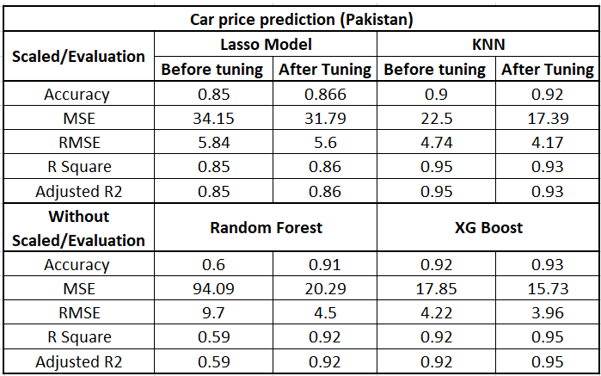
Result Summary Car price prediction Dataset-2
Used cars
&
Car insurance
claim
With a 93 percent accuracy and a 15.75 least RMSE, Tuned XG boost surpassed all other
models in predicting car pricing, according to the tableTable shows that the Tuned XG boost
outperformed all other models in

Slide 7
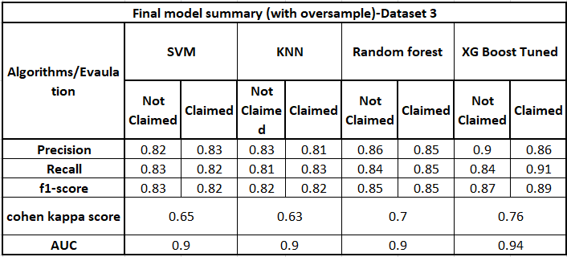
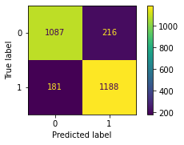
Result Summary Car insurance claim Dataset-3
Used cars
&
Car insurance
claim
Tuned XG boost yielded the best recall result, correctly predicting
91 percent of default claimants and having the lowest false-negative
value of any model with an AUC of 0.94 and F1 score of 0.89

Slide 8
Thank You
&
Have a good day

